Slide 1
Heart Disease Prediction
Using Machine Learning

Slide 2
Index
Introduction
Description of the Dataset
Data Pre-processing
Heatmap
Checking the Distribution of the Data
Applying predictive models
Logistic Regression
Theory
Implementation
Decision Tree Classification
Theory
Implementation
Random Forest Classifier
Theory
Implementation
Conclusion
Future Prospects of Heart Disease Prediction

Slide 3
Introduction
Among various life-threatening diseases, heart disease has garnered a great deal of attention in medical research. The diagnosis of heart disease is a challenging task, which can offer automated prediction about the heart condition of patient so that further treatment can be made effective. The diagnosis of heart disease is usually based on signs, symptoms and physical examination of the patient. There are several factors that increase the risk of heart disease, such as smoking habit, body cholesterol level, family history of heart disease, obesity, high blood pressure, and lack of physical exercise.
A major challenge faced by health care organizations, such as hospitals and medical centers, is the provision of quality services at affordable costs. The quality service implies diagnosing patients properly and administering effective treatments. The available heart disease database consists of both numerical and categorical data. Before further processing, cleaning and filtering are applied on these records in order to filter the irrelevant data from the database. The proposed system can recognize patterns and relationships associated with heart disease from a historical heart disease database. It can also answer the complex queries for diagnosing heart disease; therefore, it can be helpful to health care practitioners to make intelligent clinical decisions. Results showed that the proposed system has its unique potency in realizing the objectives of the defined mining goals.

Slide 4
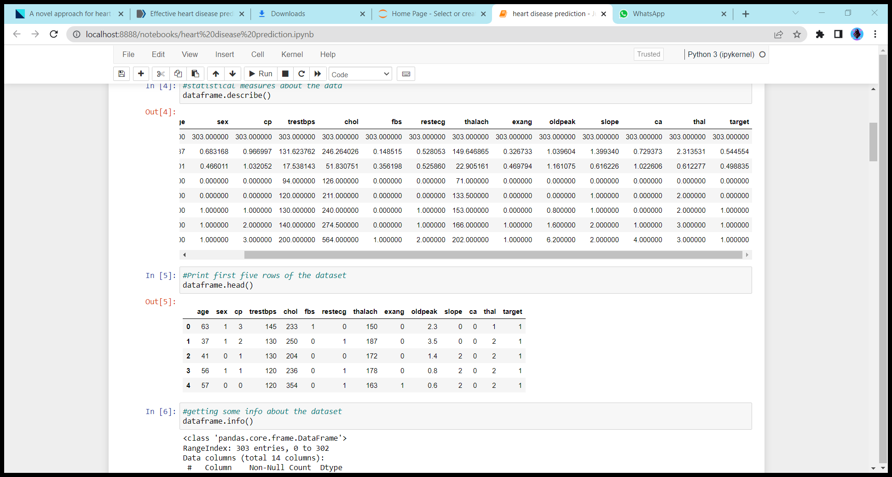
Description of the Dataset
Feature List: age, sex, cp, trestbps, chol, fbs, restecg, thalach, exang, oldpeak, slope, ca, thal, condition Feature Types: All features are numerical features.
FEATURES
1. age | Number of years a person has lived 2. sex | Gender of patient (Male:1/Female:0) 3. cp | Chest Pain type (4 values) 4. trestbps | Resting Blood Pressure 5. chol | serum cholesterol in mg/dl 6. fbs | Fasting Blood Sugar > 120 mg/dl 7. restecg | Resting Electrocardiographic (ECG) results (values 0,1,2) 8. thalach | Maximum Heart Rate Achieved 9. exang | Exercise Induced Angina 10. oldpeak | oldpeak = ST depression induced by exercise relative to rest 11. slope | the slope of the peak exercise ST segment 12. ca | number of major vessels (0-3) colored by fluoroscopy 13. thal | Thallium stress test results: 3 = normal; 6 = fixed defect; 7 = reversable defect
TARGET VARIABLE Target: diagnosis of heart disease (angiographic disease status) Value 0: < 50% diameter narrowing (negative for disease) Value 1: > 50% diameter narrowing (positive for disease)

Slide 5
Data Pre-processing
Data preprocessing is a process of preparing the raw data and making it suitable for a machine learning model. It is the first and crucial step while creating a machine learning model.
When creating a machine learning project, it is not always a case that we come across the clean and formatted data. And while doing any operation with data, it is mandatory to clean it and put in a formatted way. So for this, we use data preprocessing task.
It involves below steps:
Getting the dataset
Importing libraries
Importing datasets
Finding Missing Data
Encoding Categorical Data
Splitting dataset into training and test set
Feature scaling

Slide 6
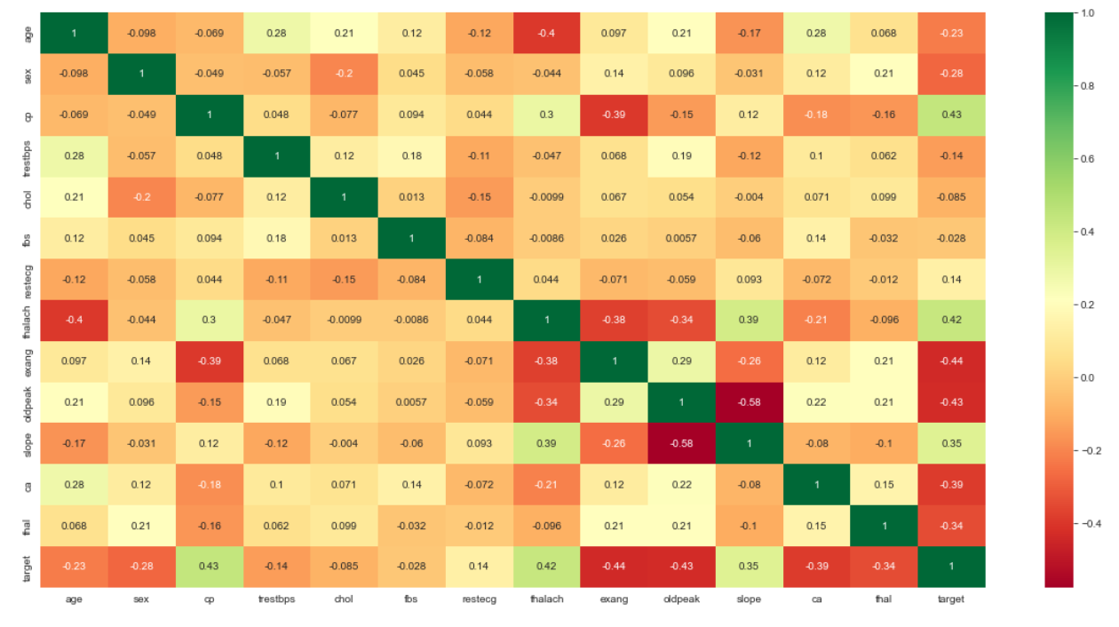
Heatmap
A Heat map is a graphical representation of multivariate data that is structured as a matrix of columns and rows.
Heat maps are very useful in describing correlation among several numerical variables, visualizing patterns and anomalies.
In this case we can see the correlation between the attributes.The conclusion that can be drawn from this heatmap is that target has inverse high correlation with exang and high correlation with thalach.

Slide 7
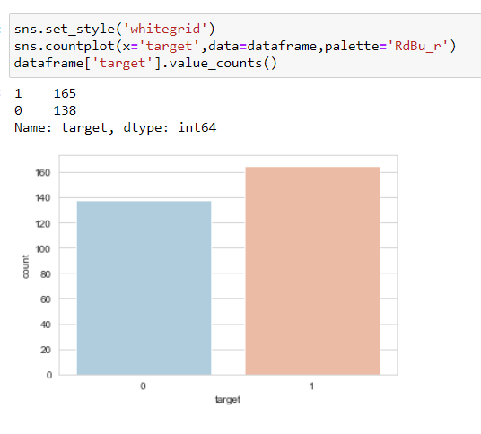
Checking the Distribution of the Data
The distribution of the data plays an important role when the prediction or classification of a problem is to be done. We see that the heart disease occurred 54.46% of the time in the dataset, whilst 45.54% was the no heart disease. So, we need to balance the dataset or otherwise it might get overfit.

Slide 8
Logistic Regression
Logistic regression is one of the most popular Machine Learning algorithms, which comes under the Supervised Learning technique. It is used for predicting the categorical dependent variable using a given set of independent variables.
Logistic regression predicts the output of a categorical dependent variable. Therefore the outcome must be a categorical or discrete value. It can be either Yes or No, 0 or 1, true or False, etc. but instead of giving the exact value as 0 and 1, it gives the probabilistic values which lie between 0 and 1.
Logistic Regression is much similar to the Linear Regression except that how they are used. Linear Regression is used for solving Regression problems, whereas Logistic regression is used for solving the classification problems.
In Logistic regression, instead of fitting a regression line, we fit an "S" shaped logistic function, which predicts two maximum values (0 or 1).
The curve from the logistic function indicates the likelihood of something such as whether the cells are cancerous or not, a mouse is obese or not based on its weight, etc.
Logistic Regression is a significant machine learning algorithm because it has the ability to provide probabilities and classify new data using continuous and discrete datasets.

Slide 9
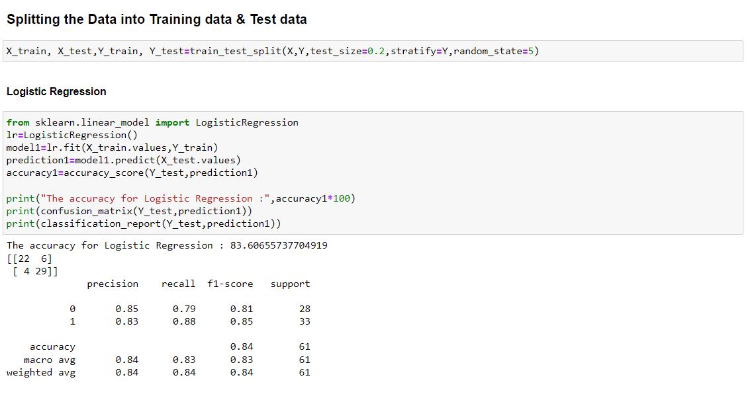
Steps in Logistic Regression:
To implement the Logistic Regression using Python, we will use the same steps as we have done in previous topics of Regression. Below are the steps:
Data Pre-processing step
Fitting Logistic Regression to the Training set
Predicting the test result
Test accuracy of the result(Creation of Confusion matrix)
Visualizing the test set result.

Slide 10
Decision Tree Classification
Decision Tree is a Supervised learning technique that can be used for both classification and Regression problems, but mostly it is preferred for solving Classification problems. It is a tree-structured classifier, where internal nodes represent the features of a dataset, branches represent the decision rules and each leaf node represents the outcome.
In a Decision tree, there are two nodes, which are the Decision Node and Leaf Node. Decision nodes are used to make any decision and have multiple branches, whereas Leaf nodes are the output of those decisions and do not contain any further branches.
The decisions or the test are performed on the basis of features of the given dataset.
It is a graphical representation for getting all the possible solutions to a problem/decision based on given conditions.
It is called a decision tree because, similar to a tree, it starts with the root node, which expands on further branches and constructs a tree-like structure.
In order to build a tree, we use the CART algorithm, which stands for Classification and Regression Tree algorithm.
A decision tree simply asks a question, and based on the answer (Yes/No), it further split the tree into subtrees.

Slide 11
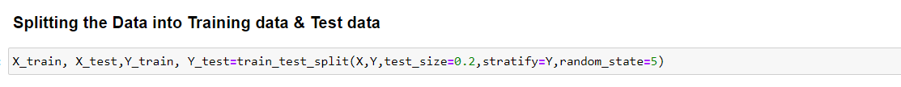
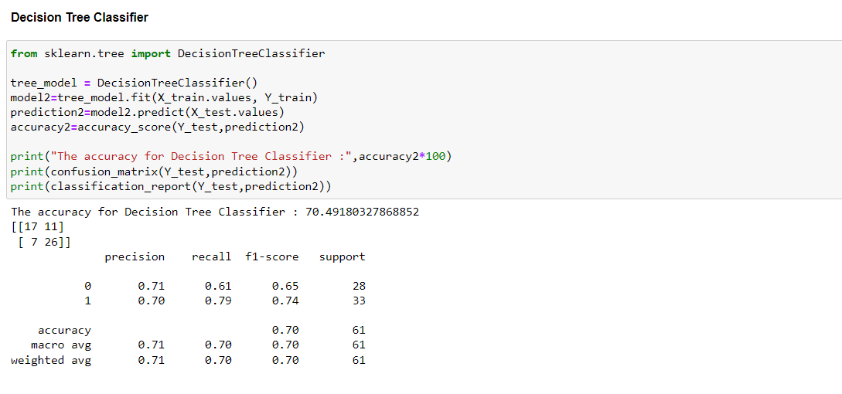
Steps in Decision Tree Classifier
Data Pre-processing step
Fitting a Decision-Tree algorithm to the Training set
Predicting the test result
Test accuracy of the result(Creation of Confusion matrix)
Visualizing the test set result.

Slide 12
Random Forest Classifier
Random Forest is a popular machine learning algorithm that belongs to the supervised learning technique. It can be used for both Classification and Regression problems in ML. It is based on the concept of ensemble learning, which is a process of combining multiple classifiers to solve a complex problem and to improve the performance of the model.
As the name suggests, "Random Forest is a classifier that contains a number of decision trees on various subsets of the given dataset and takes the average to improve the predictive accuracy of that dataset." Instead of relying on one decision tree, the random forest takes the prediction from each tree and based on the majority votes of predictions, and it predicts the final output.
The greater number of trees in the forest leads to higher accuracy and prevents the problem of overfitting.

Slide 13
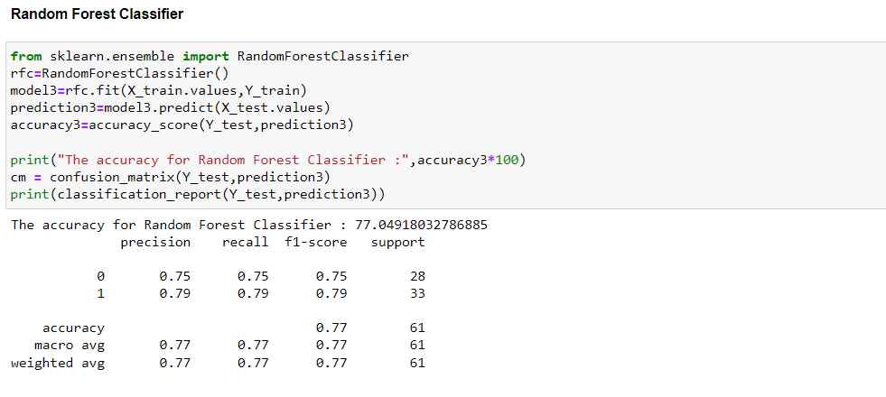
Steps in Random Forest Classifier
Implementation Steps are given below:
Data Pre-processing step
Fitting the Random forest algorithm to the Training set
Predicting the test result
Test accuracy of the result (Creation of Confusion matrix)
Visualizing the test set result.

Slide 14
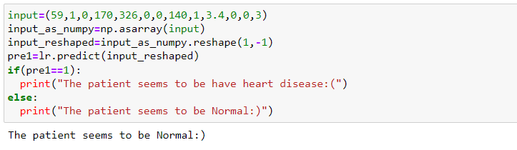
Conclusion
We proposed three methods in which comparative analysis was done and promising results were achieved. After applying all the algorithm we come to conclusion that Logistic regression gives us the highest accuracy and works best in our case.

Slide 15
Future Prospects of Heart Disease Prediction
The dataset size can be increased and other optimizations can be used and more promising results can be achieved. Machine learning and various other optimization techniques can also be used so that the evaluation results can again be increased. More different ways of normalizing the data can be used and the results can be compared. And more ways could be found where we could integrate heart-disease-trained ML models with certain multimedia for the ease of patients and doctors.It we decrease the risk of life of the patients in future and also will be more affordable.

